Slide 1
theology
Lesson 5: Christianity, pt 1

Slide 2
Christianity
Christians see evidence of god everywhere; history, theology, philosophy, science, mathematics, and logic all point to the existence of a creator

Slide 3
christianity
If the universe were disorderly or chaotic, we couldn’t expect it to behave in meaningful ways under controlled conditions

Slide 4
christianity
God’s orderly nature led to modern science
People expected law in nature because they believed in a legislature

Slide 5
2nd Law of thermodynamics
The amount of usable energy in a closed system will decrease over time

Slide 6
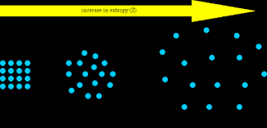
2nd law
Anything that is organized tends, with time, to become disorganized

Slide 7



Slide 8
Spontaneous generation
The idea that life was spontaneously generated through chance circumstances

Slide 9
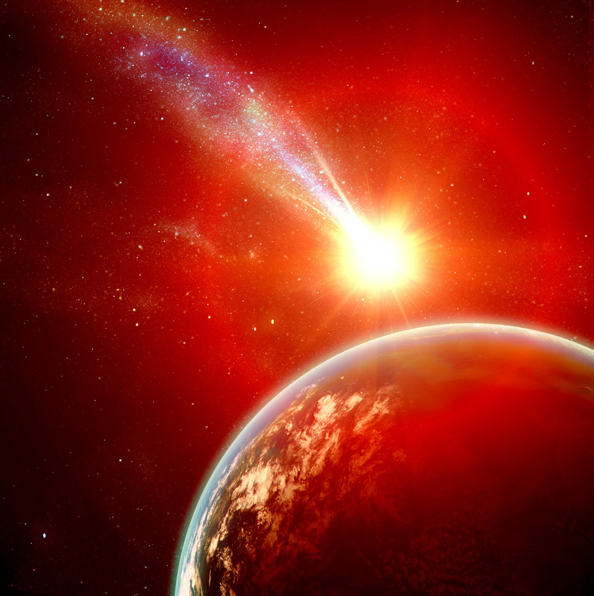
spontaneous
This has not been observed; only speculated
God as creator is the only explanation

Slide 10
Genetic information theory
Genetics indicates the presence of information of design

Slide 11
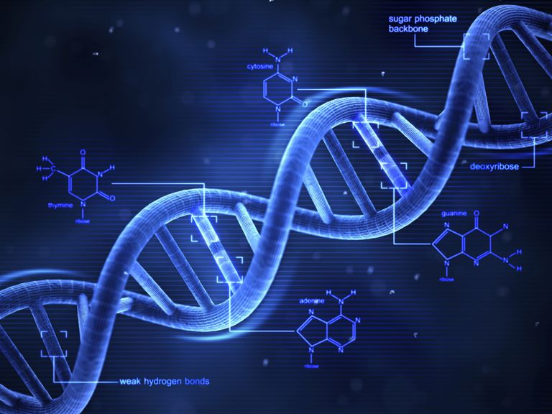
Genetic info.
Information is the hallmark of a creator

Slide 12
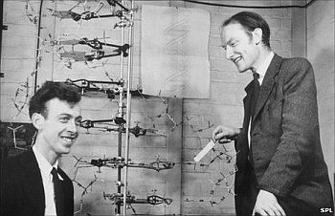
Genetic info.
Dr. james Watson and dr. francis crick were the discoverers of dna.

Slide 13
Anthropic principle
The universe was designed for man to live in it

Slide 14
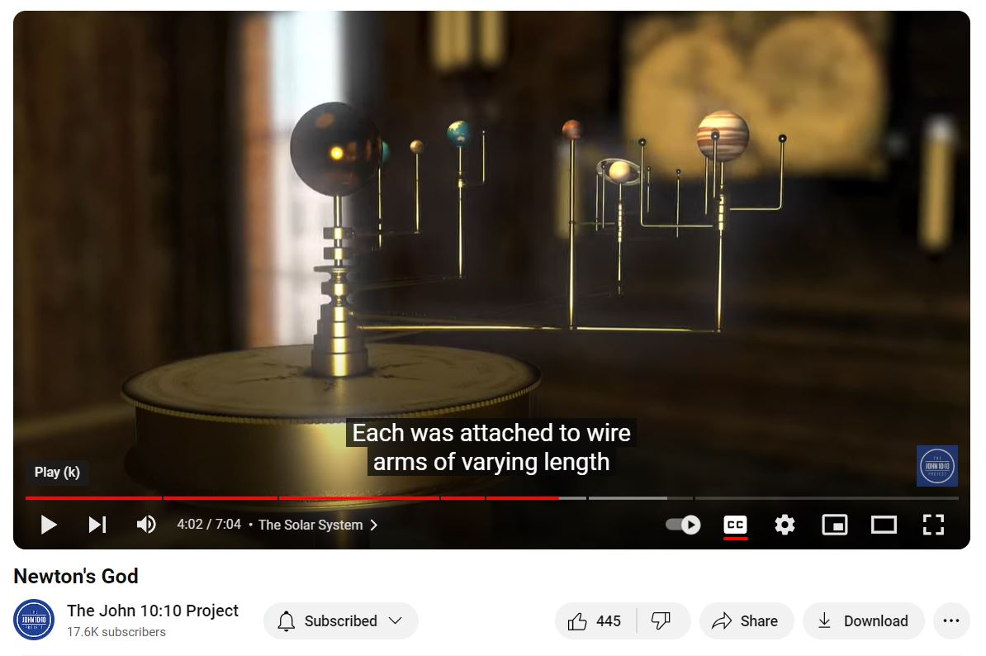
Notes:
A third way Newton found a role for God in the world was as the source of its orderly structure. In the cosmic order, Newton saw evidence of Intelligent design. The main business of science, he said, is to argue backward along the chain of mechanical causes and effects “until we come to the first cause which is certainly not mechanical.” Newton also regarded several specific characteristics of the world as inexplicable except as the work of the Creator. “Was the eye conrtrived without skill in optics,” he asked, “ or the ear without knowledge of sounds?”
Newtons favorite argument from design, however, focused on the solar system whose delicately balanced structure he felt clearly indicated intelligent design. If the speed of the planets were just slightly different, if the mass of the sun were just slightly more or less, the entire system would not work. Newton concluded that the solar system could not be explained by natural causes alone.- “which are blind or fortuitious”- but only by a cause “very well skilled in mechanics and geometry.” In the General Scholium, Newton write, “The most beautiful system of sun, planets, and comets could only proceed from the counsel and dominion of an intelligent and powerful being.” Indeed Newtons image of the universe as a finely tuned machine or “contrivance” in itself fostered the idea of a Creator just as the watch implies an existence of a watchmaker. “The whole form of Newtonian science,” write historian John Herman Randall, “ practically forced men, as a necessary scientific hypothesis to believe in an external Creator.”
-The Soul of Science
Pearcey and Thaxton
page 90-91

Slide 15
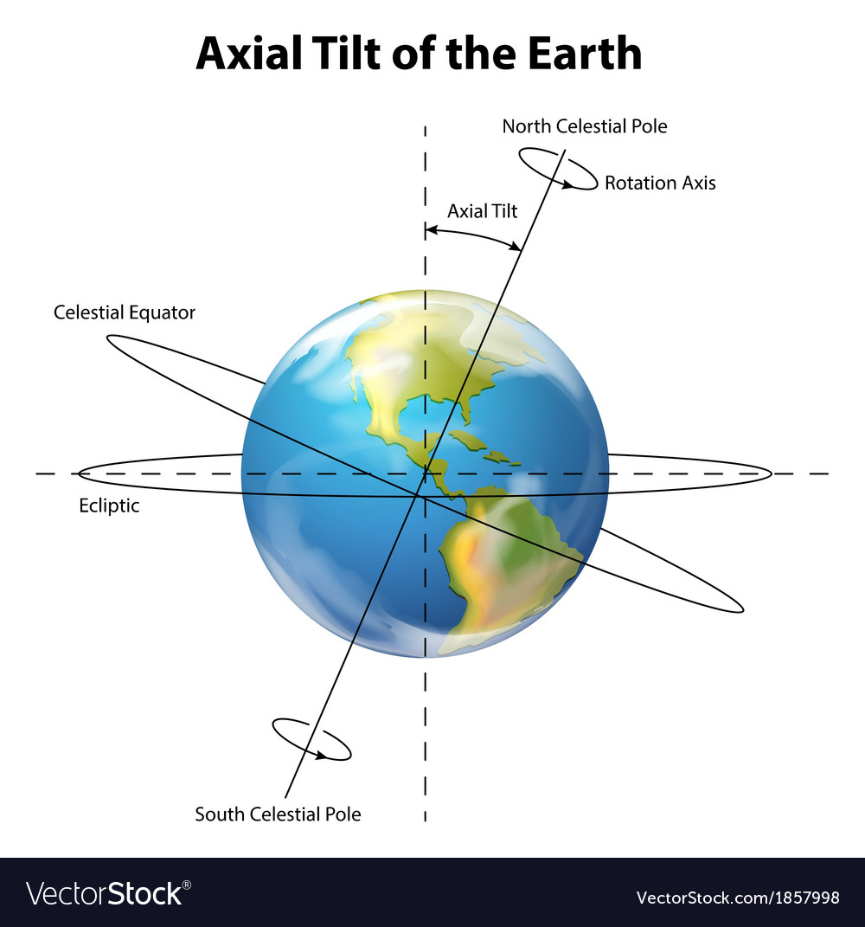
Oxygen content of the earth
Tilt of the earth

Slide 16

Temperature of the earth
Gravitational pull

