Slide 1
theology
Lesson 4: theistic worldviews

Slide 2
New spirituality
NS embraces pantheism, which says everything is god
God is a word to describe the spiritual energy of which the universe is composed

Slide 3
New spirituality
Ns ascribes divine characteristics to energy as the source of all things
New spiritualists worship the creation and the creator at the same time

Slide 4
New spirituality
In other words, there is not a transcendent god, god is the creation

Slide 5

Romans 1:25
because they exchanged the truth about God for a lie and worshiped and served the creature rather than the Creator, who is blessed forever! Amen.

Slide 6


Slide 7


Slide 8
islam
Islam is similar to Christianity; it adheres to monotheism
They believe there is god who created the world

Slide 9
islam
They reject the trinity; they believe this to be polytheism
Islam defines the nature and character of god differently than christianity

Slide 10
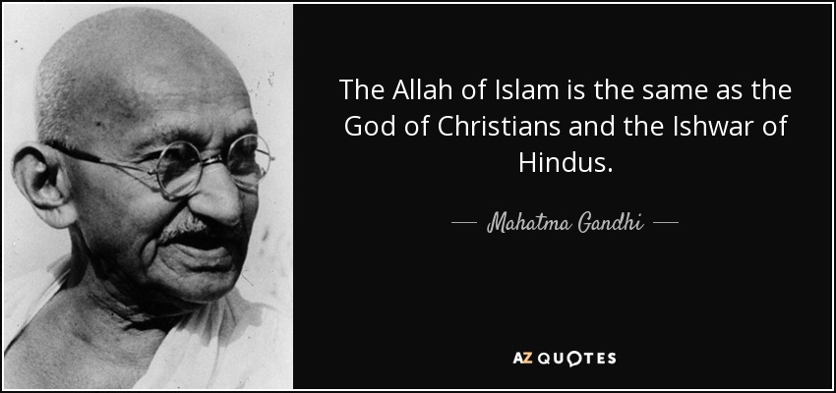

Slide 11
islam
Jesus is not god’s son, he is simply a holy prophet
Jesus did not die on the cross according to muslims

Slide 12
marxism
Marx believed the working class would fail to rise up if they had hope in eternal life

Slide 13
marxism
Liberation theology is a political movement that interprets the teachings of jesus as a call to liberate the poor from social, economic, and political oppression

Slide 14
postmodernism
Postmodernists are atheists by consequence
They believe god is a socially constructed meta-narrative; therefore they cannot trust he is real

Slide 15
postmodernism
Postmodernists can best be characterized as having theological suspicion

Slide 16
Religious pluralism
Descriptive pluralism
Prescriptive pluralism
We must learn to tolerate each other in our religious beliefs
There are many different religions and none of them are true

Slide 17
